Slide 1
Customer Club
Nitol Motors Ltd

Slide 2
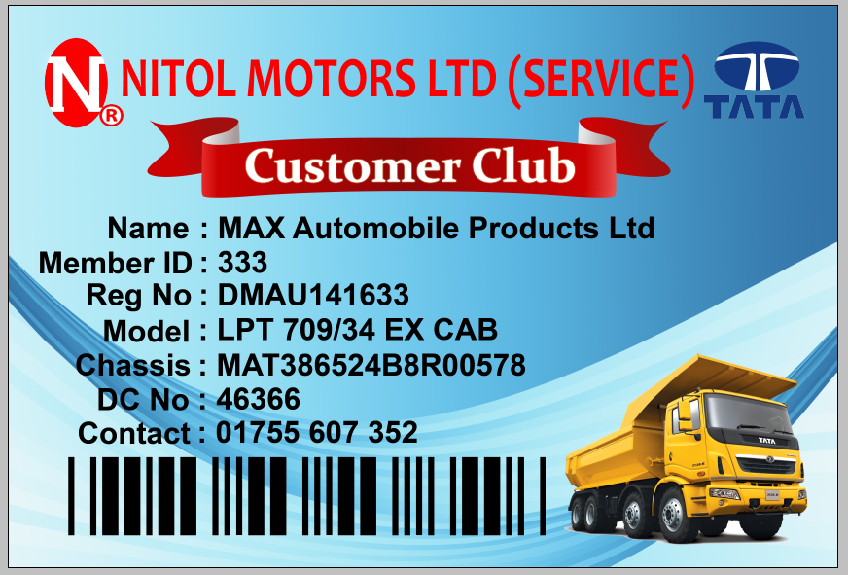
Sample Card

Slide 3
Software Screen

Slide 4
Features
Built in system towards point accumulation for exciting gift.
Easy to use via Radio Frequency Identification (RF ID) and Bar Code system.
Instant Job Card opening via single click.
Microchip controlled card to keep information.
Accessible from anywhere in Bangladesh.
Has scope for adding new technological features for enhanced customer support.
Visual security (Hologram) integrates.
Can monitor vehicle movement.
One card many solutions, for a simpler future.
Developed and maintain within the organization.

Slide 5
Thank You

